Slide 1
Economics 144 Economic Forecasting
Lecture 3
Modeling and Forecasting Trend
(Part I)
Dr. Randall R. Rojas

Slide 2
Today’s Class
Loss Function
Modeling Trend
Linear
Quadratic
Log-linear
Exponential
Model Selection
R Demo

Slide 3
Loss Function _{1 of 4}
Good forecasts lead to good decisions!
→ Strong link between forecasts and decisions.
Example: You started a firm and need to decide (now) how much inventory to hold going into the next sales period.
Strategy
Demand is high → build inventory
Demand is low → reduce inventory

Slide 4
Loss Function _{2 of 4}
 | Demand High | Demand Low
Build Inventory
Reduce Inventory
Loss
0
$10,000
$10,000
0
Symmetric Loss Structure: Both bad outcomes have the same loss.
 | Demand High | Demand Low
Build Inventory
Reduce Inventory
Loss
0
$10,000
$20,000
0
Asymmetric Loss Structure: Outcomes have different losses.

Slide 5
Loss Function _{3 of 4}
For every decision-making problem, there is an associated loss structure; for each decision/outcome pair, there is an associated loss.
0 → Correct Decision
>0 → Incorrect Decision
Loss
We could also forecast the sales!
 | High Actual Sales | Low Actual Sales
High Forecasted Sales
Low Forecasted Sales
Loss
0
$10,000
$10,000
0
Forecasting with Symmetric Loss: Both bad forecasts have the same loss.

Slide 6
Loss Function _{4 of 4}
Forecast Error (e): Difference between the realization (y) and the previously made forecast(ŷ) → e = y - ŷ
Loss Function (L(e)): Loss associated with a forecast. Must satisfy: (1) L(0)=0,(2) L(e) is continuous, and (3) L(e) is increasing on each side of the origin.
Examples of
loss functions:
Absolute Loss Function
L(e) =|e|
Quadratic Loss Function
L(e) =e²
Loss
Loss
Error
Error

Slide 7
Modeling Trend
Trend: Is slow , long-run evolution in the variables that we want to model and forecast.
Deterministic Trend: Trend evolves in a perfectly predictable way.
To characterize a particular trend, we need a model. For example, in the case of linear regression, the model is: y_{t} = β₀ + β₁ x _{t}
Often, given the broad range of time scales encountered in time-series, it is convenient to adopt one common time variable (time dummy or time trend) such that: TIME* = (1, 2,…,T) where TIME=1 is the first period of the sample, and so on.
*The notation convention is TIME_{t} = t.

Slide 8
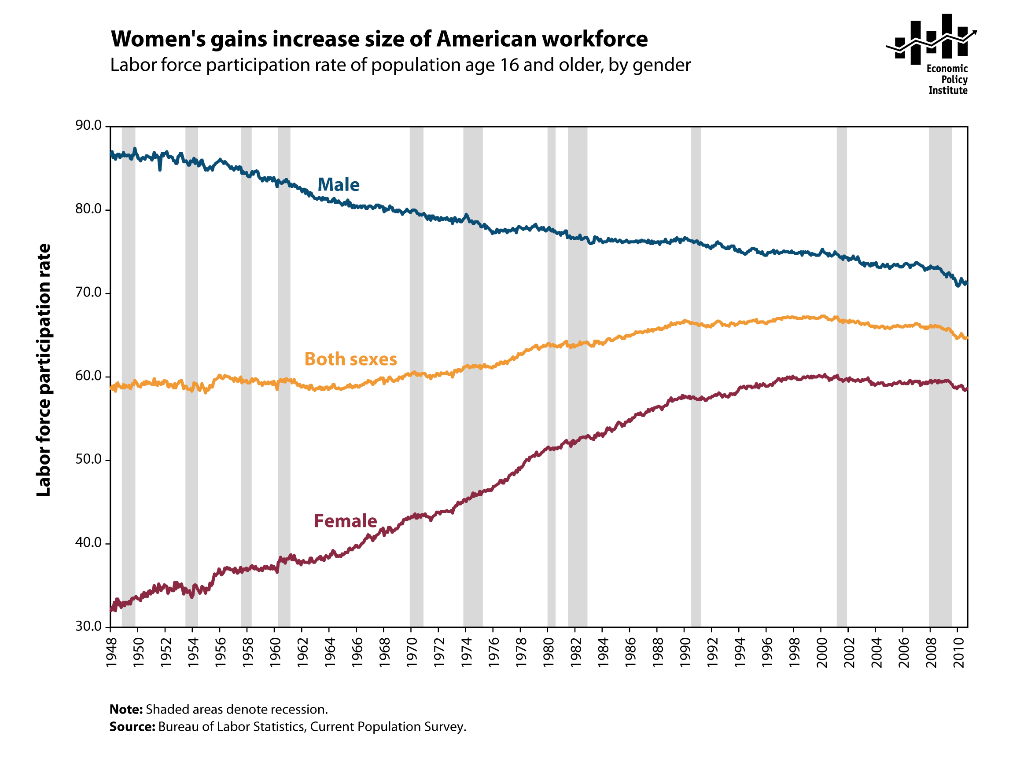
Modeling Trend (Linear) _{1 of 4}
http://stateofworkingamerica.org/charts/labor-force-participation-rate-of-population-age-16-and-older-by-gender/
Decreasing
Increasing
Model: T_{t} = β₀ + β₁ TIME _{t}

Slide 9
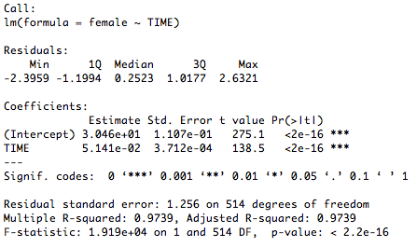
Modeling Trend (Linear) _{2 of 4}
Female Data
Fitted
Actual
R² =0.97→Excellent!
Do you see anything wrong?
Time : 1948-1990

Slide 10
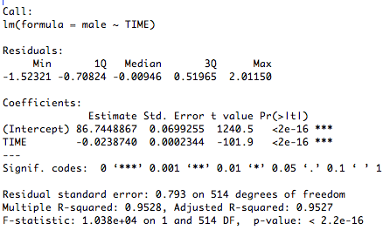
Modeling Trend (Linear) _{3 of 4}
Male Data
Fitted
Actual
R² =0.95→Excellent!
Do you see anything wrong?
Time : 1948-1990

Slide 11
Modeling Trend (Linear) _{4 of 4}
U.S. Recession
Bands
Model: T_{t} = β₀ + β₁ TIME _{t}

Slide 12
Modeling Trend (Quadratic)
Model: T_{t} = β₀ + β₁ TIME _{t} +β₂ TIME²

Slide 13
Modeling Trend (Log-Linear)
Model: log(T_{t}) = β₀ + β₁ TIME _{t}

Slide 14
Modeling Trend (Exponential)
Model:

Slide 15
Model Selection via AIC and BIC
Model | df | AIC | BIC
Linear | 3 | 1229.0482 | 1241.7865
Quadratic | 4 | 808.3932 | 825.3776
Log-Linear | 3 | -3361.0625 | -3348.3242
Exponential | 3 | 1160.3758 | 1173.1141
The smaller the AIC/BIC value, the better the model.
Both AIC and BIC select the quadratic fit as the preferred model.

Slide 16
Forecasting Trend _{1 of 2}
Example (Point Forecast): Initially at T, and want to use a trend model to forecast the h-step-ahead value.
Assume a linear trend:
At time T+h:
Point forecast:
However, β₀ and β₁ are unknown. Solution: replace them with their LS estimates and .
Point Forecast:
~ 0 (zero-mean random noise)
Forecast is for t = T+h but based on t =T

Slide 17
Forecasting Trend _{2 of 2}
Example (Interval Forecast): Same idea as before. Assume the trend regression disturbance is normally distributed, then:
Interval Forecast:
In practice, use:
Example (Density Forecast): Same idea, yet again!
Density Forecast:
In practice, use:

Slide 18
Forecasting Trend (Example)
95% Confidence Interval 95% Prediction Interval

Slide 19
For Next Class
Readings about today’s class:
Chapter 5^{b}
Review Exercises / Problems:
Chapter 3^{b}: 1, 2, 3, 5
Chapter 4^{b}: 4, 5, 9
Chapter 5^{b}: 1, 6
Readings for next class:
Chapter 5^{b}: Forecasting Retail Sales

